Slide 1
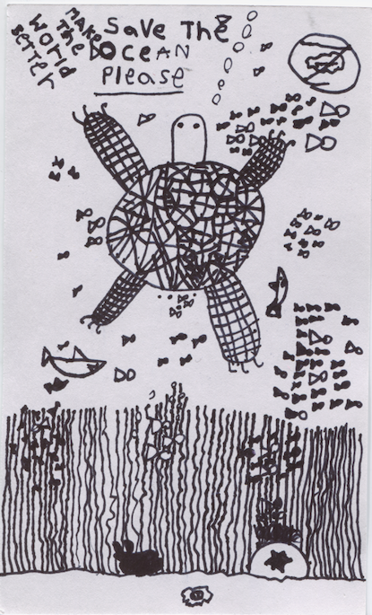

Slide 2
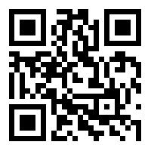
Global Education
Thanks to the American Center for Mongolian Studies, Avoca District 37 tuition reimbursement, and the Illinois Computing Educators for funding my study in last summer’s field school
Thanks to National Geographic for including me in the Educator Community Steering Committee, 2018-2019
Thanks to the NEA Foundation for teaching me about Global Studies this year!
Janis Michael
Exploremongolia.org
janismch2@gmail.com
Notes:
There are many incredible organizations out there that are developing resources, courses, and leadership opportunities for teachers who are interested in Global Education. You can bring the world into your classroom virtually and through your own direct experiences.

Slide 3
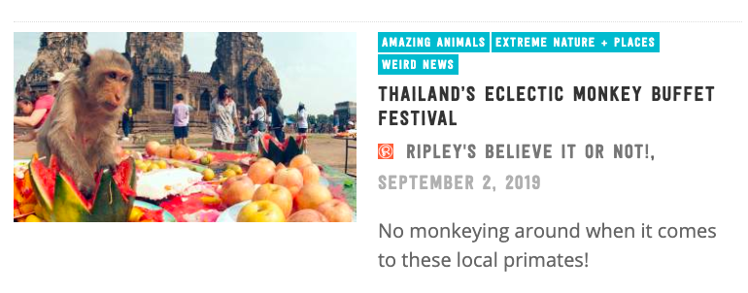
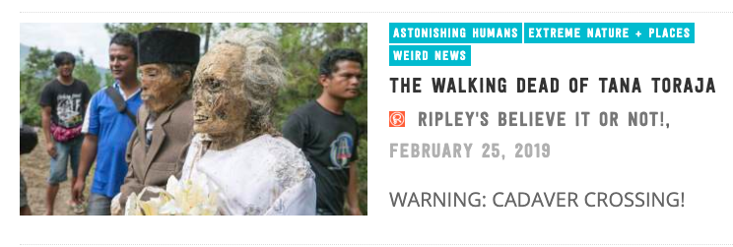
Global Education:
Not Just
Notes:
Too often we present the world to students through "odd practices" and "weird stuff." It’s the “Five Cool Facts” approach--reducing peoples and cultures to curiosities.

Slide 4
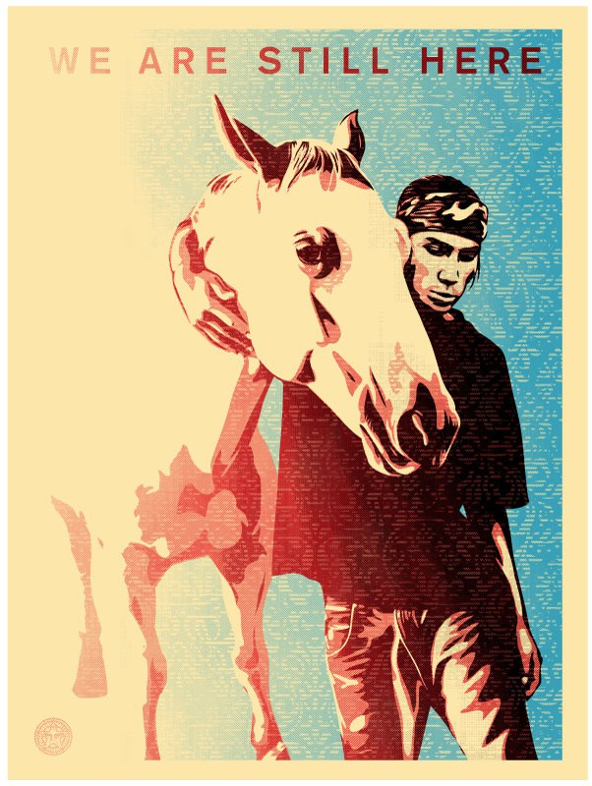
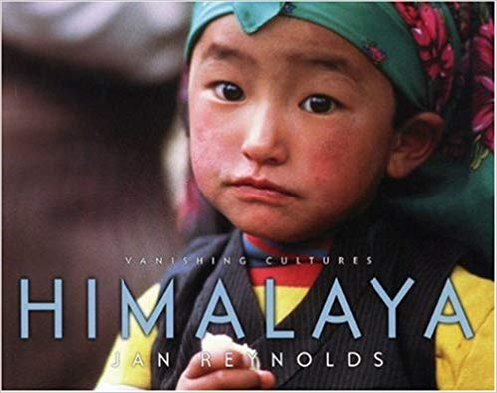
I’m still here.
Reproduced with permission of Aaron Huey, all rights reserved
Vanishing
Notes:
Another popular approach to global education is the wistful and rather colonial or Orientalist approach. Cultures that are different from mainstream European and North American cultures are quaint, but vanishing--not a challenge to our own lives or beliefs. By the way, the “vanishing cultures” series isn’t bad: it was itself a rebellion against the factoid approach to world cultures. However, in spite of its good intentions, it retains that wistful view of non-Western cultures that gives students the impression that they are quaint and irrelevant.

Slide 5
Yet
Another
Global Education: Framework
Reasons & respect for differences
Empathy for struggles
Alliances for change
Civility not condescension
Healing the wounds of genocide
and racism
To teach genuine empathy and respect, not just prurient interest, wistful regret, and the belief that we can “fix” someone else’s struggles, we need:
Notes:
Yet Another Framework: This one helps me remember that differences in the way we live are rooted in geography, culture, religion, economics, and the history of racism and oppression. We aren’t here to fix each other, but to support each other’s efforts without imposing a belief in our superiority to others.

Slide 6
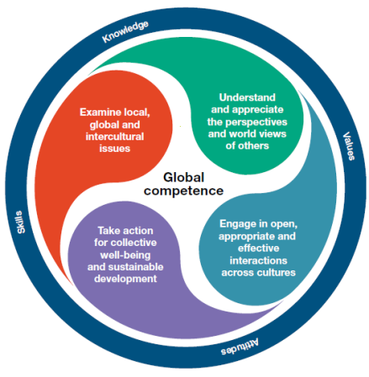
Global Education: A Framework
Reasons and respect for differences
Empathy for struggles
Alliances for change
Civility not condescension
Healing the wounds of genocide
and racism
PISA, framework for Global Competence
Notes:
As I have worked with a variety of frameworks, I’ve found that they tend not to emphasize the need to form alliances of respect with others. Perspective-taking is foundational, as are “understanding” and “appreciation.” However, all of these are words which still allow students to distance themselves from others. I saw the need for a ladder that coaches students to discoveries about how differences come from people’s efforts to fill their needs within their geographic, economic, and cultural environments. Differences emerge from differing struggles and different approaches to shared struggles. The way to take action is to form alliances, not to impose an outside view of the actions that need to be taken in a given area.
I also approach this as a historian who feels that the different manifestations of struggle in different areas of the globe have emerged from a racist and colonial past and present. If we continue to look at Global Education and Global Competence without considering that history, we fail to give our struggles and practices any context.

Slide 7
Reasons and respect for differences
Notes:
Kids love poop. It would be easy to show kids how many varieties of toilets there are in the world and hear them make various disgusted noises with great verve and delight. It is harder to get them to see that lots of factors come into the kind of sanitary facilities available, and that theirs are just as odd and place/culture specific as anyone else’s.

Slide 8
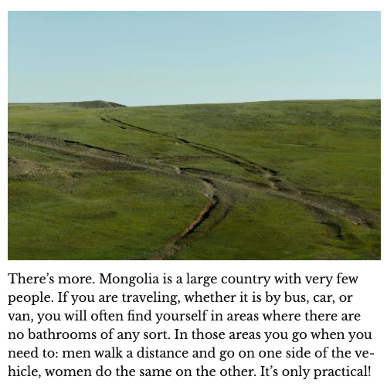
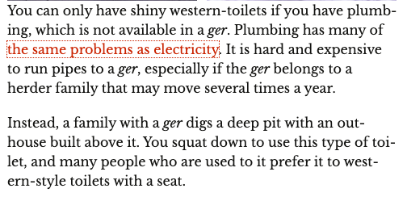
Reasons and respect for differences
Notes:
So an outhouse isn’t necessarily gross or disgusting--it is a way of providing sanitary facilities where there is no plumbing. Going wherever you are is a solution to travel through areas that are sparsely populated. These solutions can be unsanitary disease-spreaders or the only available reasonable option depending on circumstances and, in the case of outhouses, location and execution.

Slide 9
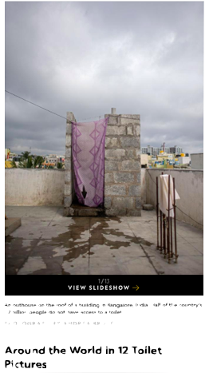
Reasons and respect for differences
“Understand that different cultures have different reasons for building toilets,” says Ann Olga Koloski-Ostrow, chair of the classics department at Brandeis University in Waltham, Massachusetts, and author of The Archaeology of Sanitation in Roman Italy. “Not everybody thinks like the Western world.”
National Geographic, “World Toilet Day,” November 2016
Notes:
This National Geographic site adds information about the need for sanitation facilities in poorer countries. So, we go from why people might prefer different facilities to why people can’t always have what they want or what is healthy.
With reasoning comes respect. Students should come to understand that different customs, practices, and economic cir

Slide 10
Reasons and respect for differences
What’s respect?
“Showing that you appreciate someone by being kind and listening.” (a 10-year-old)
Respect for differences-- listening to why differences exist and not assuming that your way is best!

Slide 11
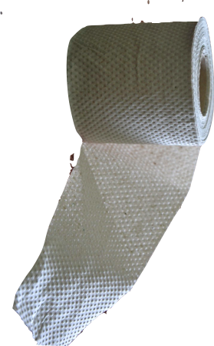
Reasons and respect for differences
Read the National Geographic article on toilets. Some differences in the types of toilets people use are due to different needs in different cultures and places. Some differences are the result of poverty (not having money).
Why do we have the types of toilets that we have? Think about:
Are plumbing and sewer lines available throughout your community?
What are the health effects of not having plumbing and sewer lines in cities?
What are some problems caused by Western-style bathrooms? Advantages?
How do your culture and community feel about privacy when using the bathroom?
How do your culture and community feel about different genders and bathroom use?
Is there toilet paper in most bathrooms or do you carry your own? What does your response tell you about your community?
Notes:
Here are a few starter questions--kids will have many more. There are lots of sites they can explore to find solutions that people have created for sanitary facilities where plumbing and sewer lines are not available. You can definitely bring in things like bidets and the middle-eastern lota jug. What about toilet paper? Do you expect to find it in toilet areas or do you carry it with you? What does that tell you about your country?

Slide 12
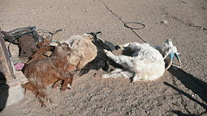
Empathy for struggles
Brücke-Osteuropa, Wikimedia Commons
Notes:
In a herder culture, what is the biggest disaster? Climatic conditions that wipe out your herds. This is called a dzud or zud.

Slide 13
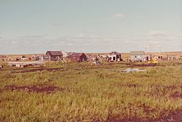
Empathy for struggles
Climate Change Changes Everything
In Mongolia, a nation of herders, climate change has stolen economic stability from herders. Many have moved to crowded and polluted Ulaanbaatar as a result.
In Kiribati, climate change has stolen the land itself. Preparations were made under the previous government for “migration with dignity” to Fiji.
In Newtok, Alaska, this Yup’ik village had to move because the permafrost is melting.
Brucke-Osteuropa, Wikimedia Commons
https://mapswire.com/australia/political-maps/
Ernie Tyler from Ramona, CA, USA
Notes:
We can empathize with each other’s struggles by looking at our own and at commonalities throughout the world. In this case, by looking at the effects of climate change on different places we can understand that while the effects may differ, in each case it leads to impoverishment and displacement.

Slide 14
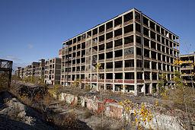
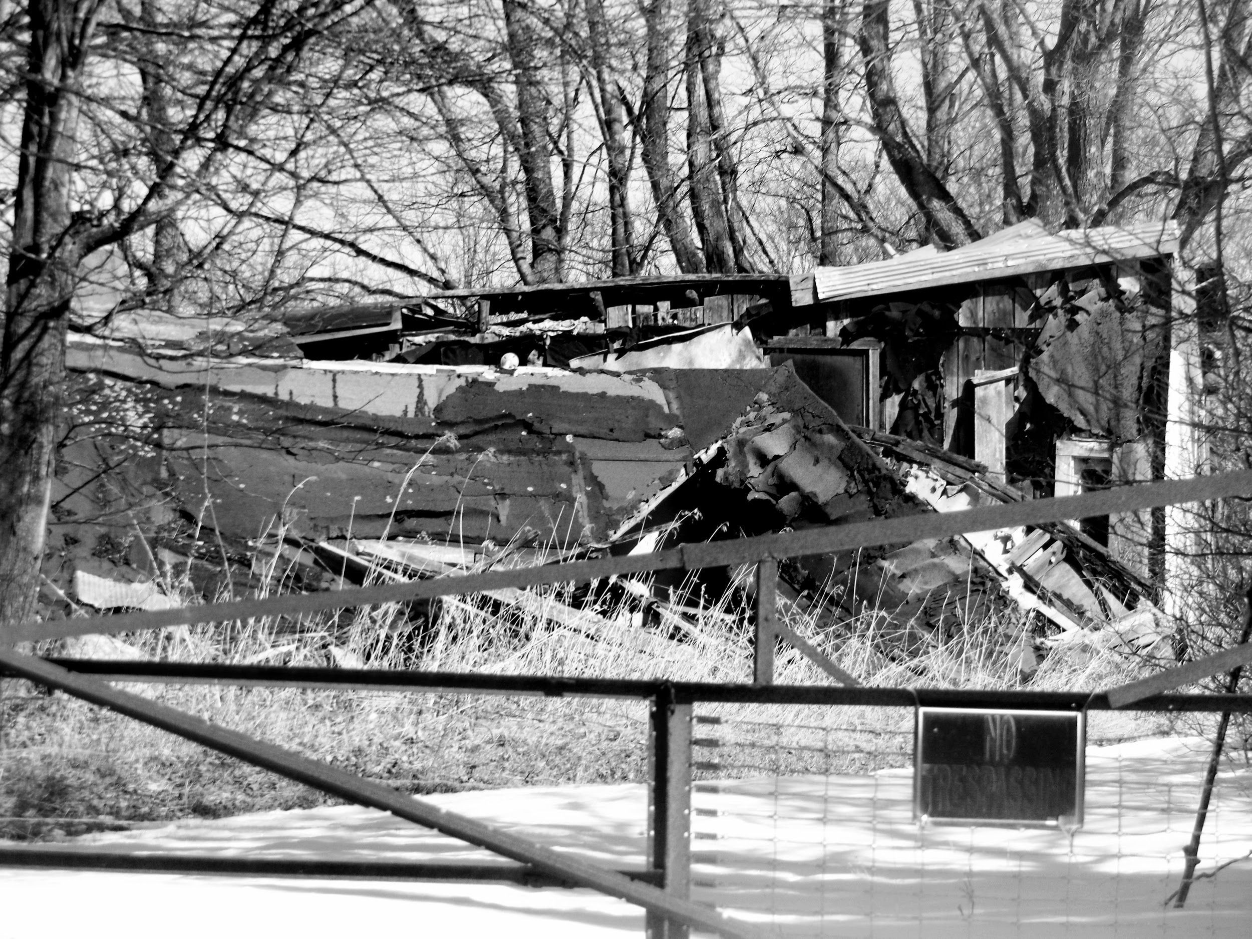
Empathy for struggles
Economic and Technological Change are Everywhere
In Mongolia, a nation of herders, climate change has stolen economic stability from herders.
In Detroit, a city of factories, changes in the economy and where factories are located have stolen economic stability from former auto workers.
In the American midwest, a land of small farms, changes in farming technology have led to almost all small farms being erased by factory farms or development..
Brucke-Osteuropa, Wikimedia Commons
Albert Duce, Wikimedia Commons
Ray Michael-Schwartz, 2018 all rights reserved.
Notes:
We can look at the same issue in Mongolia from the perspective of those who lose their ability to earn a living through changes beyond their individual control.

Slide 15
Empathy for struggles
Notes:
Climate action, decent work and economic growth, quality education, and most of the other goals can help students understand how their struggles connect to struggles of people all over the globe. If you go to the UNDP page, you can find more examples by selecting any one of the goals.

Slide 16
Empathy for struggles
Herders
About half of the people in Mongolia are semi-nomadic herders, dependent on their herds of camels, sheep, goals, yaks, and horses for their living. They move with their herds as seasons change to find the best places for the animals to feed and survive.
Notes:
Here’s an example: If I were teaching these struggles focusing on loss of work, I start with some background reading or full-group instruction so that they could understand the situation of Mongolian herders.

Slide 17
Empathy for struggles
Herders
Climate change is upsetting the delicate balance that allows herds to survive winter on the steppe and is turning parts of the steppe into deserts.
A dzud is a mass die-off of animals due to unusually dry summers and unusually cold winters.
Brücke-Osteuropa, Wikimedia Commons

Slide 18
Empathy for struggles
Why does it matter?
For over a thousand years people in Mongolia lived as nomadic herders, priding themselves on their horses and livestock. Many of those who lose their animals in a dzud have to give up herding and move to Ulaanbaatar: a crowded, polluted city.
Brücke-Osteuropa, Wikimedia Commons

Slide 19
Empathy for struggles
Have you read about people in the U.S. who find the factory jobs that sustained their parents and grandparents disappear?
How about the family farmers in our country who are finding that they must sell their farms?
How do these situations compare to the herder’s problems?
How do the different groups adapt to or mitigate these problems?
Brücke-Osteuropa, Wikimedia Commons
Notes:
Then students could read about and write about some struggles closer to home--in this case how people deal with the loss of a historically stable and culturally important way of supporting their families. That’s U.N. sustainability goal 8: decent work and economic growth.

Slide 20
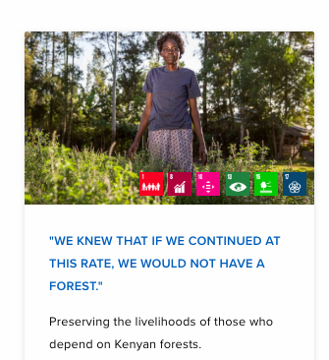
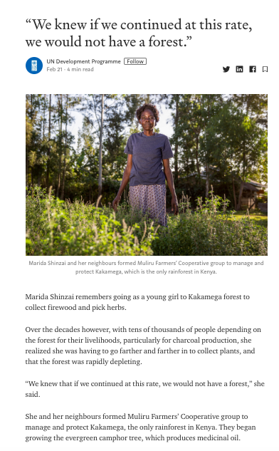
Empathy for struggles
Notes:
Another example from the UNDP site.

Slide 21
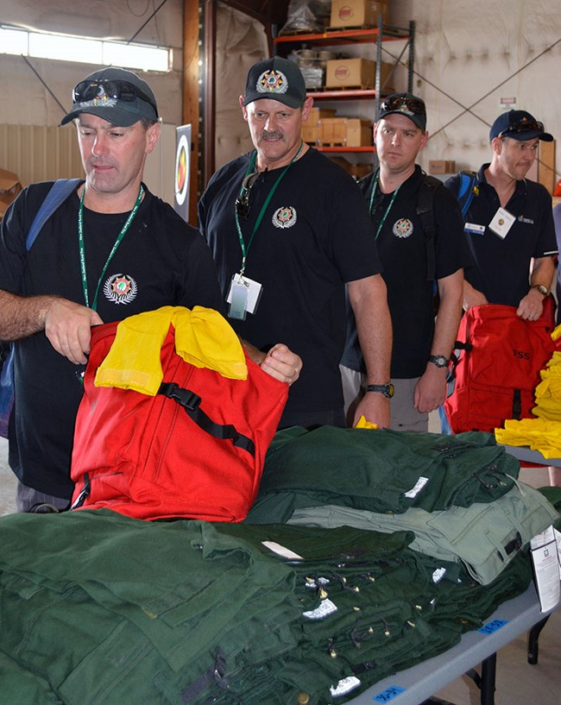
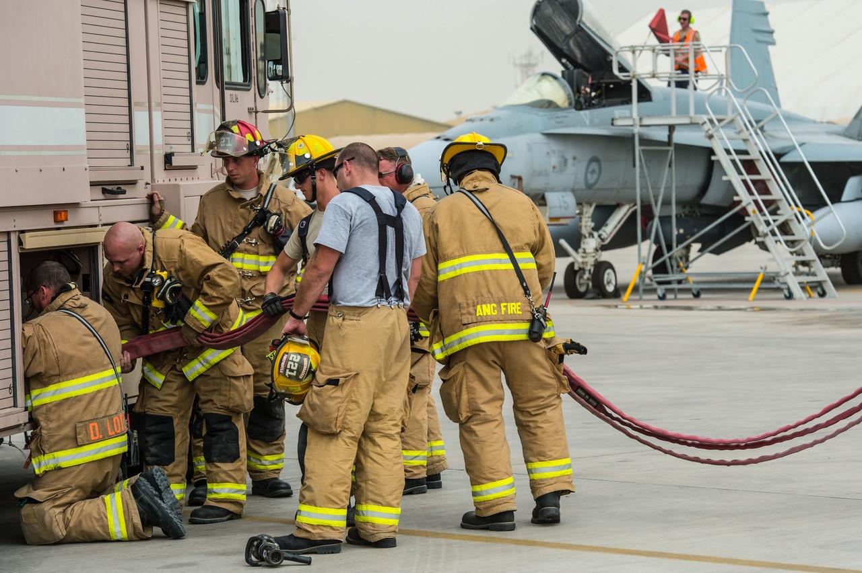
Alliances for change
Change happens with partnerships.
New Zealand firefighters in the U.S.
U.S. firefighters in Australia.
Notes:
In teaching about alliances for change, I emphasize that successful alliances are based on mutually-perceived need and on the needs of any group receiving assistance. Needs and solutions must come from those receiving assistance; in other words, ask before you help :)

Slide 22
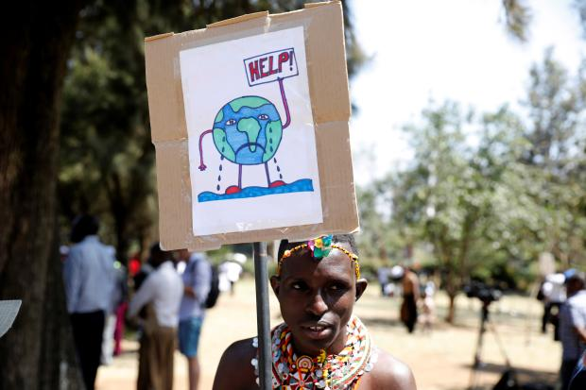
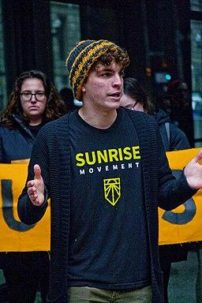
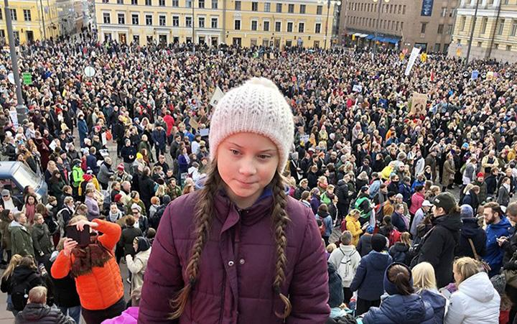
Alliances for change
Change happens with partnerships.
Greta Thunberg in Stockholm
Nairobi, Kenya
Sunrise Movement, Chicago
Notes:
Climate Change

Slide 23
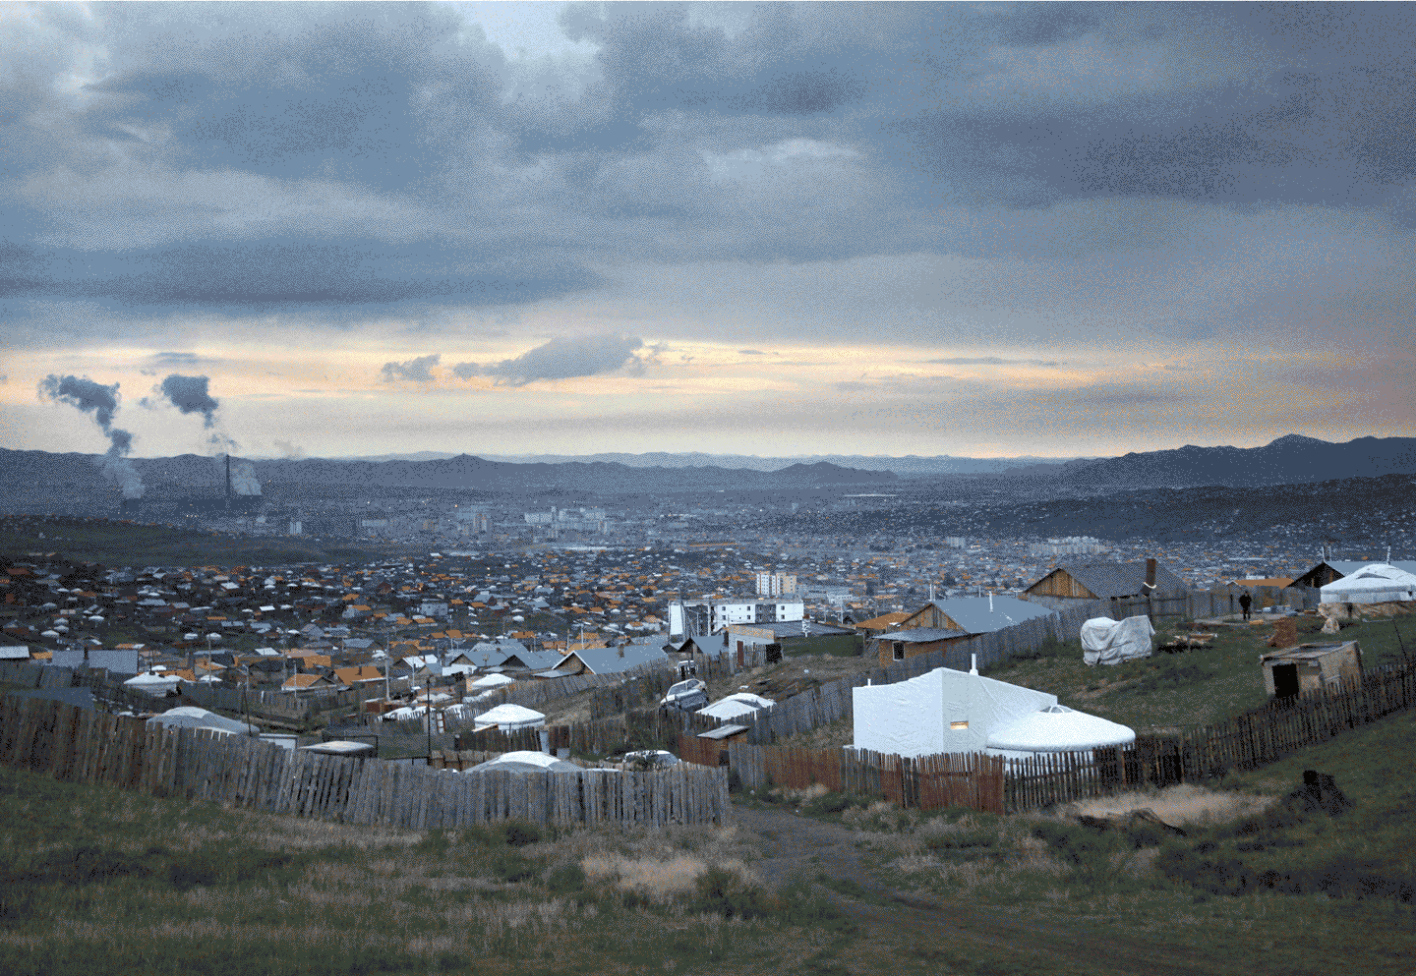
Alliances for change
Change happens with partnerships.
Notes:
Creating ger alternatives for clean air.

Slide 24
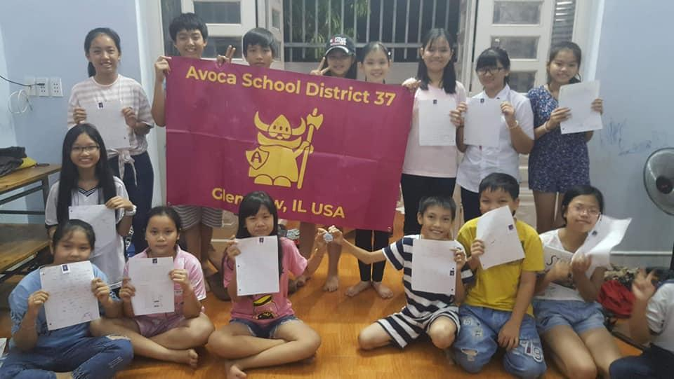
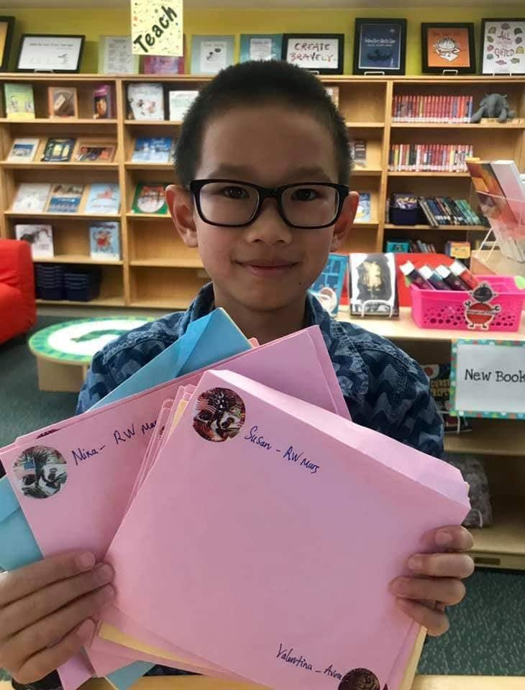
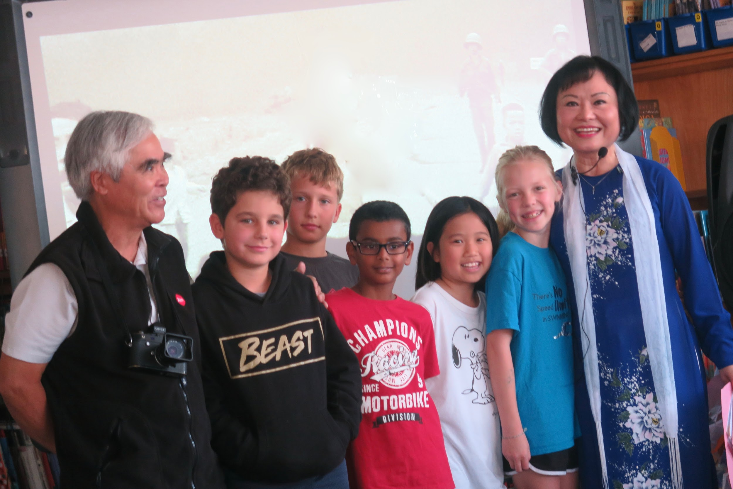
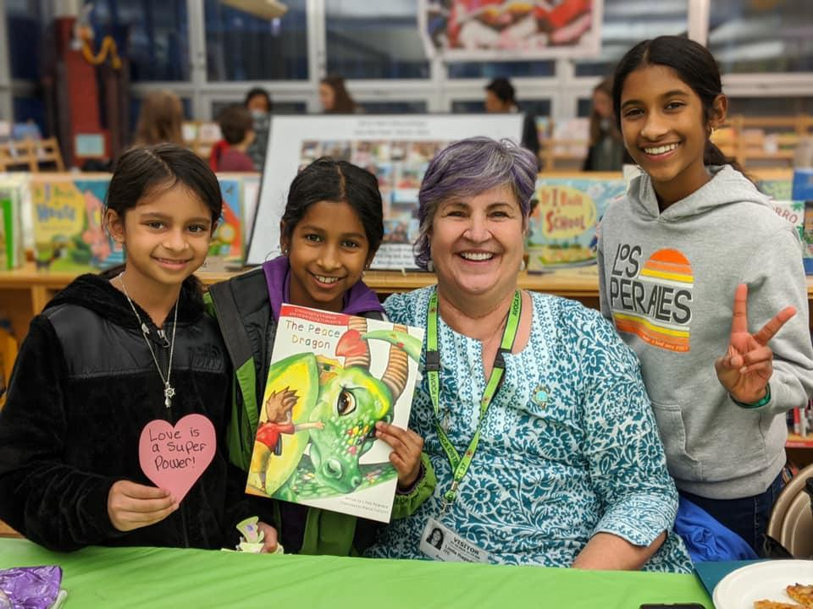
Alliances for change
Change happens with partnerships.
Building a Library
Pen Pals
Kim Phuc and Nick Ut
Peace and Pizza with Linda Ragsdale
Notes:
Vietnam needs libraries. Avoca West Elementary School librarian Susan Geidner connected with a team of kids, educators, veterans, concerned citizens and scouts to raise money to build one in Trang Bang, the city where the famous image of Kim Phuc running from her village, badly burned by napalm, was taken. The team raised $62,000 by connecting elementary school students to pen pals in Vietnam, Kim Phuc, photographer Nick Ut, author Linda Ragsdale, and Children’s Library International. Our global learners were able to support a solution that was defined by a local community on the other side of the world. That’s a true alliance for change!

Slide 25
Alliances for change
Change happens with partnerships.
Notes:
This is another one of the places where the U.N. sustainable development goals comes in. If we are working with people across the globe in alliances for change, these alliances can be guided by the sustainable development goals.

Slide 26
Civility not condescension
It’s the little things that matter.
What’s civility?
Being generous about mistakes when someone just doesn’t know about the little things
Speaking and behaving in a way that shows that you value other people.
Politeness--however that is defined.
Notes:
Respect and civility start with simple things. In the context of global education, students should become aware of the unaccountable little things that are important in their culture. Do you use certain titles for the adults in your life? Do you take your shoes off when entering a home? Do you have rules about how food is served or shared?
This picture was taken inside a Mongolian ger, where my host had handed me his snuff bottle. This is a highly valued possession, and when I took it I did not hold it correctly. A family member is demonstrating here the correct way to hold and pass the bottle.

Slide 27
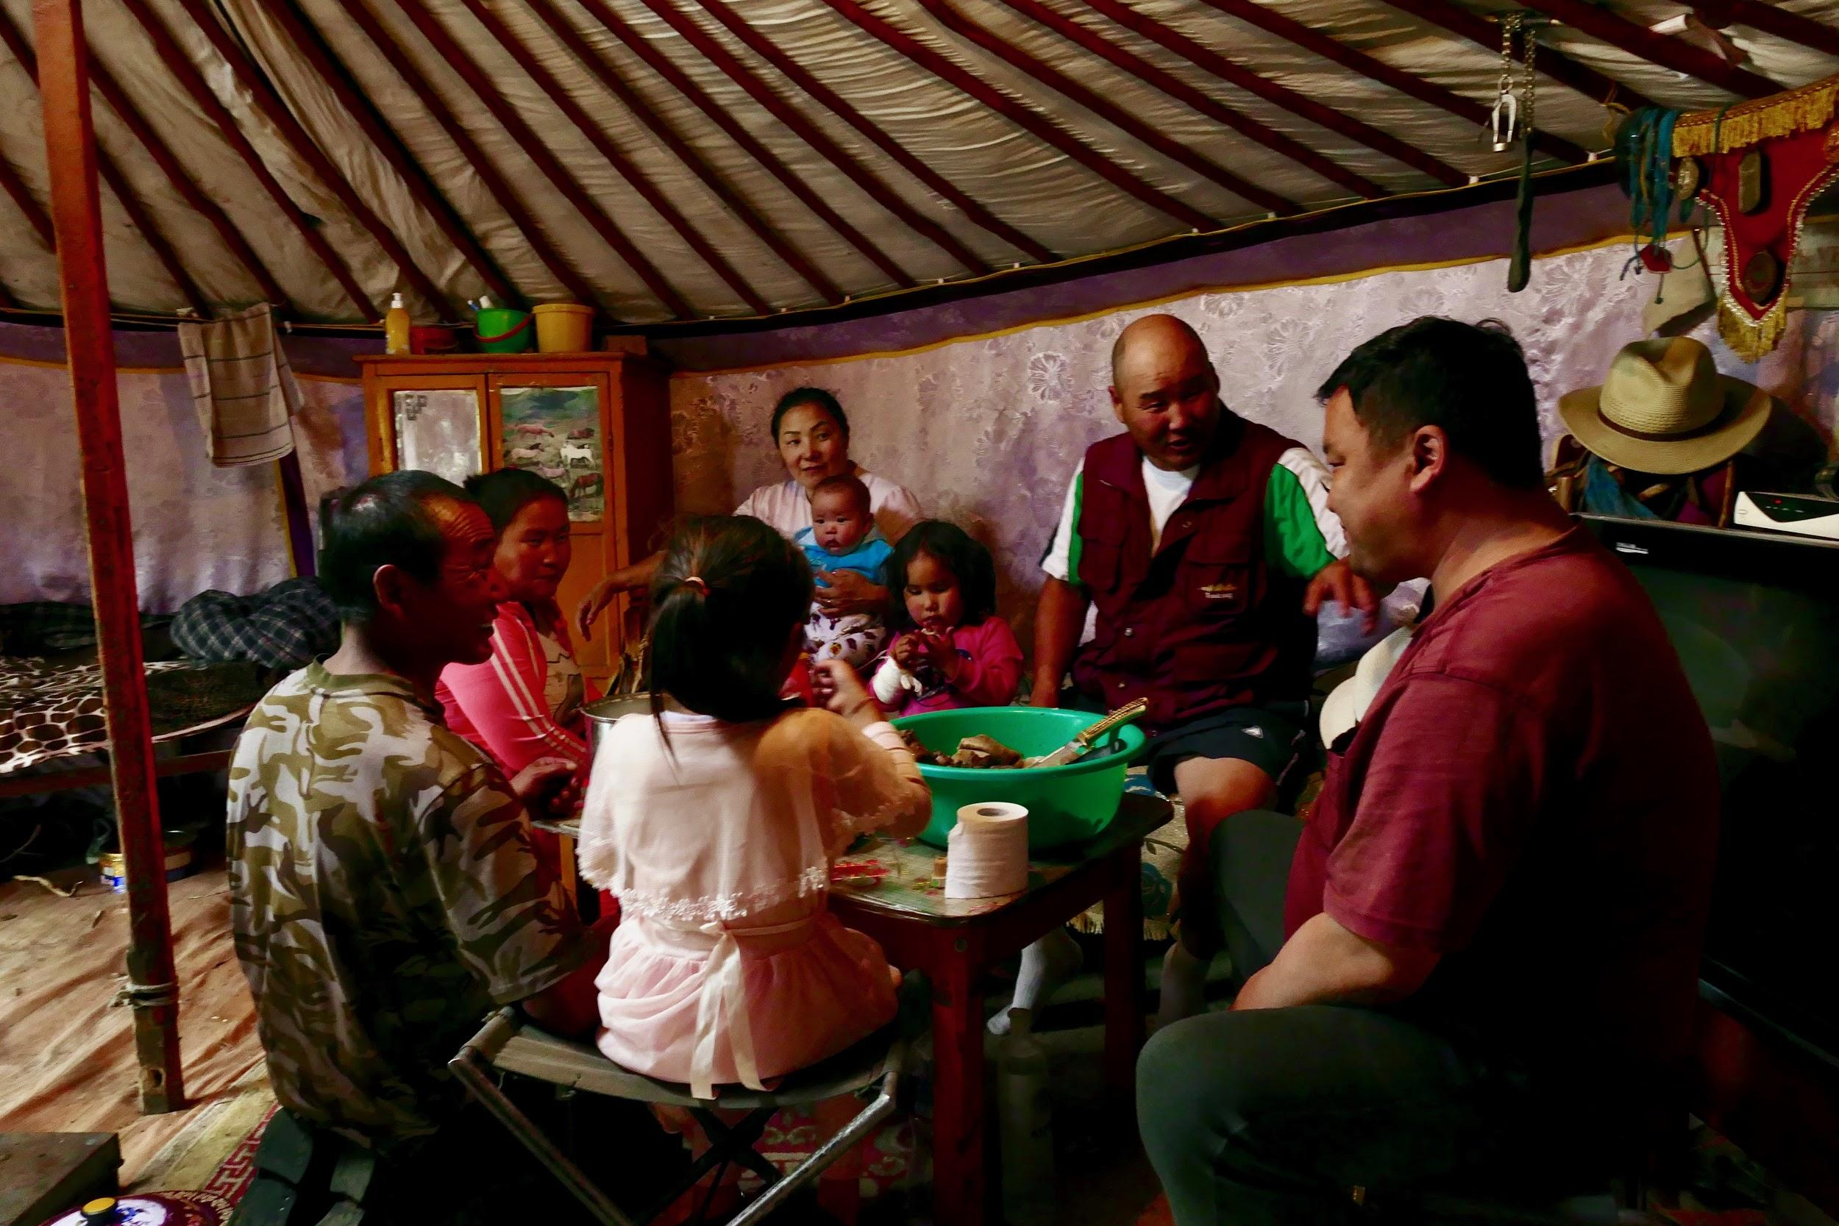
Civility not condescension
Listening, watching, and waiting your turn.
Different cultures have different rules about when it is polite to speak. In any gathering, the rules reveal themselves as you watch people interact.
Notes:
Again, a lesson might start by having students think about and observe the rules in their own households. How might an outsider figure out those rules? In this picture of a household eating together, what is missing that you might expect to see? (plates) Why might they not use plates all the time? How are they going to eat the food in the bowl?

Slide 28
Civility not condescension
Don’t assume that the way that you do things is “best” and that anyone else would choose your way if only they could!
Notes:
When I moved to Ann Arbor, Michigan after college, my New Yorker mother visited me there. After driving around the town for awhile, she sighed and commented: “I guess it is okay for people who can’t live in New York.”
That is why people make fun of New Yorkers (well, one of the reasons).

Slide 29
Civility not condescension
Don’t assume that the way that you do things is “best” and that anyone else would choose your way if only they could!
Notes:
When I moved to Ann Arbor, Michigan after college, my New Yorker mother visited me there. After driving around the town for awhile, she sighed and commented: “I guess it is okay for people who can’t live in New York.”
That is why people make fun of New Yorkers (well, one of the reasons).

Slide 30
Civility not condescension
Don’t assume that the way that you do things is “best” and that anyone else would choose your way if only they could!
Notes:
When I moved to Ann Arbor, Michigan after college, my New Yorker mother visited me there. After driving around the town for awhile, she sighed and commented: “I guess it is okay for people who can’t live in New York.”
That is why people make fun of New Yorkers (well, one of the reasons).

Slide 31
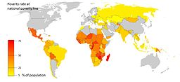
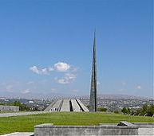
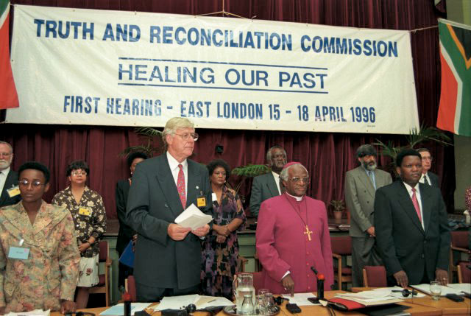
Healing the wounds of genocide and racism
African American History Museum
Armenian Genocide Memorial
Brook Ward
Rita Willaert from 9890 Gavere, Belgium / CC BY (https://creativecommons.org/licenses/by/2.0)
M Tracy Hunter / CC BY-SA (https://creativecommons.org/licenses/by-sa/3.0)
Why do some nations lack resources and live with extreme poverty?
Truth and Reconciliation, South Africa
Reparations for Slavery
Notes:
Most of our poorest nations were exploited as colonies in the past or experienced war and genocide. Many of these are also the hardest-hit by climate change. If we teach about the world without talking about the deep wounds of the past, students may see economic differences as reflections of whether people are intelligent or hard-working.

Slide 32
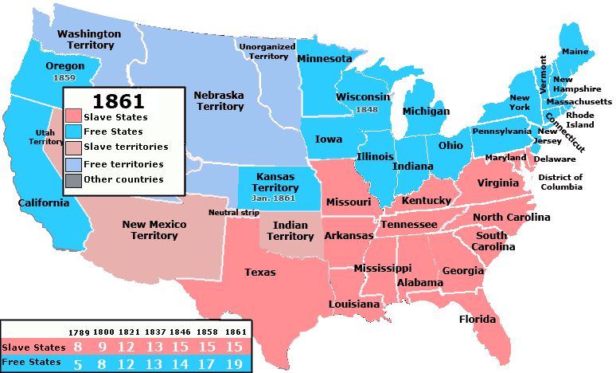
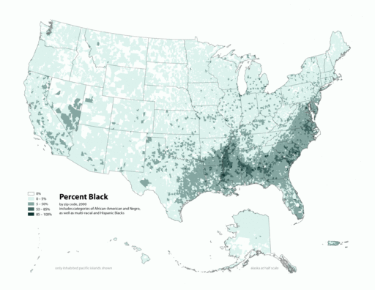
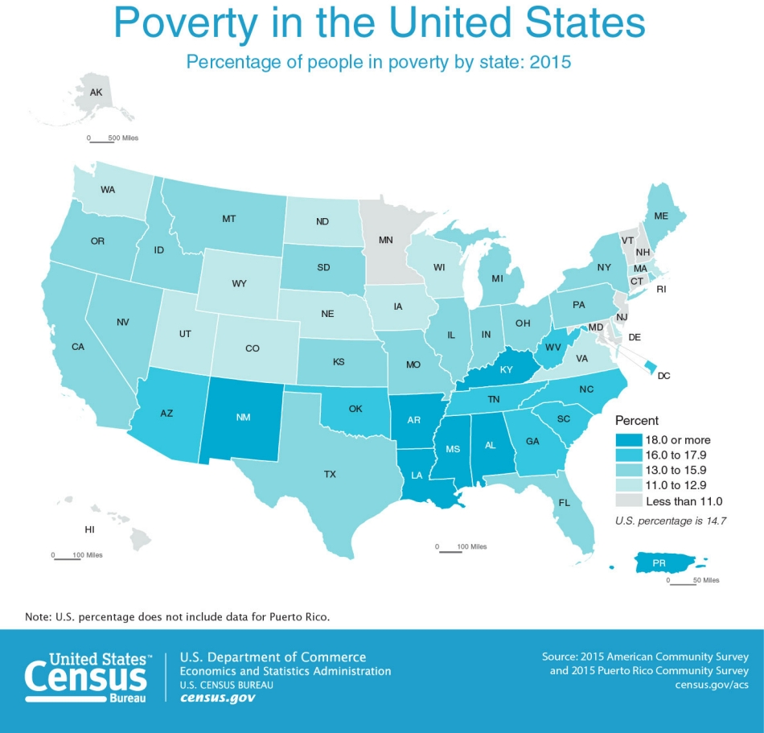
Healing the wounds of genocide and racism
United_States_1861-01-1861-02-04.png: Made by User:Golbez.derivative work: Kenmayer / CC BY (https://creativecommons.org/licenses/by/2.5)
Citynoise at English Wikipedia. / CC BY-SA (https://creativecommons.org/licenses/by-sa/2.5)
Notes:
Notice the heritage of racism and slavery: the poorest, blackest parts of our nation are the former confederacy.

Slide 33
Yet
Another
Global Education: Framework
Reasons & respect for differences
Empathy for struggles
Alliances for change
Civility not condescension
Healing the wounds of genocide
and racism
Notes:
Why Another Framework: This one focuses my teaching on connections and understanding. Students should remember that cultural, geographic, religious, and economic differences exist for for many reasons, and that they are negative only if the people involved feel that they are negative. Our job is to develop understanding and empathy and then to support each other as we try to make this a better world.

